Slide 1
CORONA VIRUS ANALYSIS
By DISHA RAJAK

Slide 2

INTRODUCTION
COVID-19 is a respiratory illness caused by the coronavirus SARS-CoV-2. It was first identified in Wuhan, China, in December 2019, hence the name COVID-19 (Coronavirus Disease 2019). The virus can cause a range of symptoms, from mild respiratory symptoms to severe illness and death, particularly in older adults and those with underlying health conditions. It spreads primarily through respiratory droplets when an infected person coughs, sneezes, or talks, and it can also spread by touching surfaces contaminated with the virus and then touching the face.

Slide 3
PROBLEM STATEMENT
The impact of COVID-19 has been profound and multifaceted. It has affected public health, economies, social interactions, and daily life worldwide and has created a urgent need for data driven insights to understand the spread of virus. This analysis uses SQL to showcase the key insights of its spread globally in year 2020 & 2021.

Slide 4
DATASET OVERVIEW
Province: Geographic subdivision within a country/region.
Country Region: Geographic entity where data is recorded.
Latitude: North - south position on Earth’s surface.
Longitude: East - west position on Earth’s surface.
Date: Recorded date of CORONA VIRUS data.
Confirmed: Number of diagnosed CORONA VIRUS – related cases.
Deaths: Number of CORONA VIRUS – related deaths.
Recovered: Number of recovered CORONA VIRUS – related cases.

Slide 5
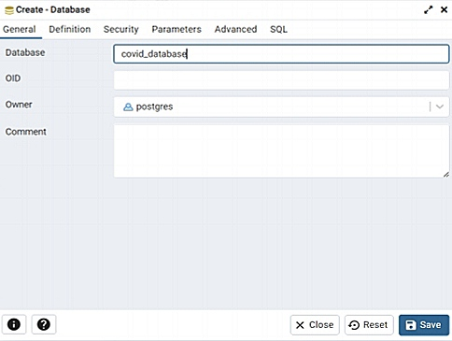
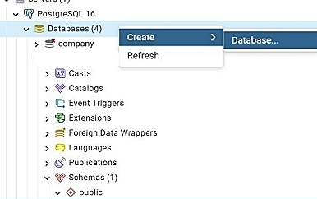
Creating database

Slide 6
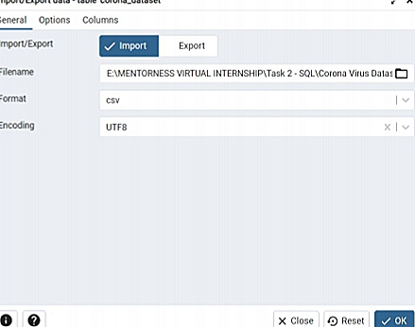
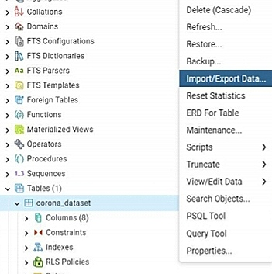
Import Data into Table

Slide 7
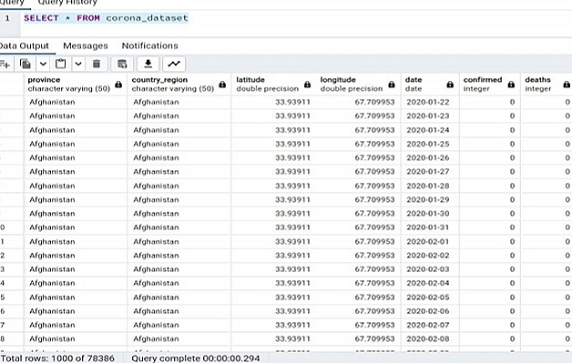
Imported Data into Table

Slide 8
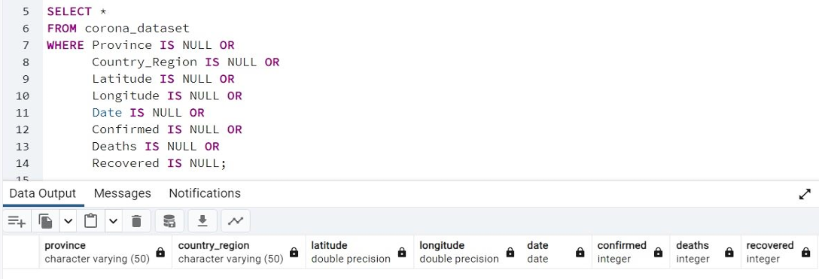
Write a code to check NULL values

Slide 9
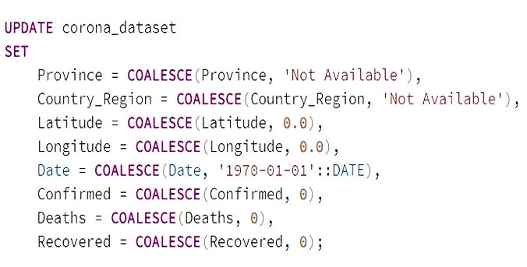
If NULL values are present, update them with zeros for all columns

Slide 10
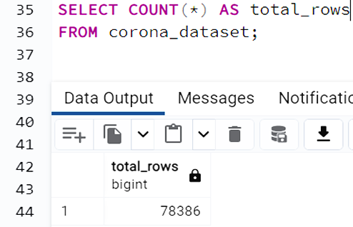
Check the total number of rows

Slide 11
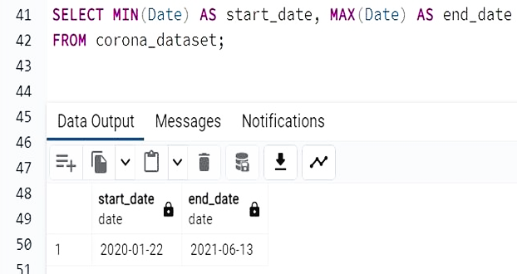
Check what is the start date and end date

Slide 12
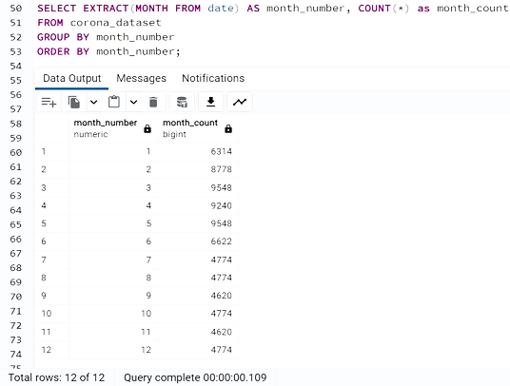
Check number of months in the dataset

Slide 13
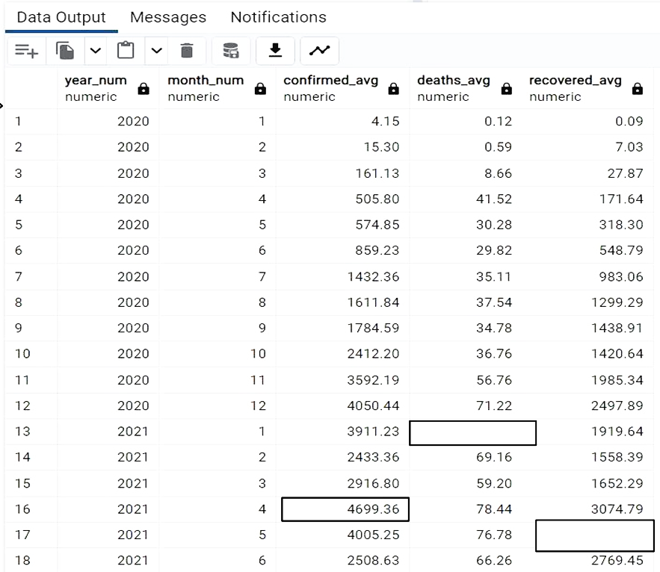
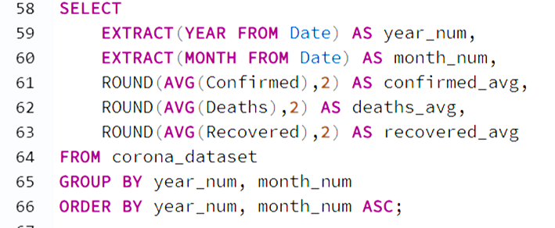
Find the monthly average for confirmed, deaths ,recovered .

Slide 14
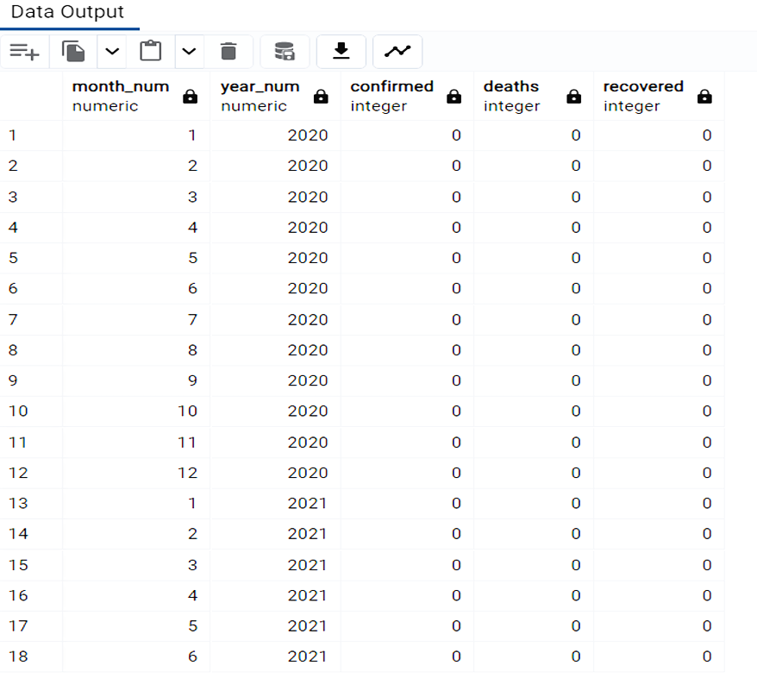
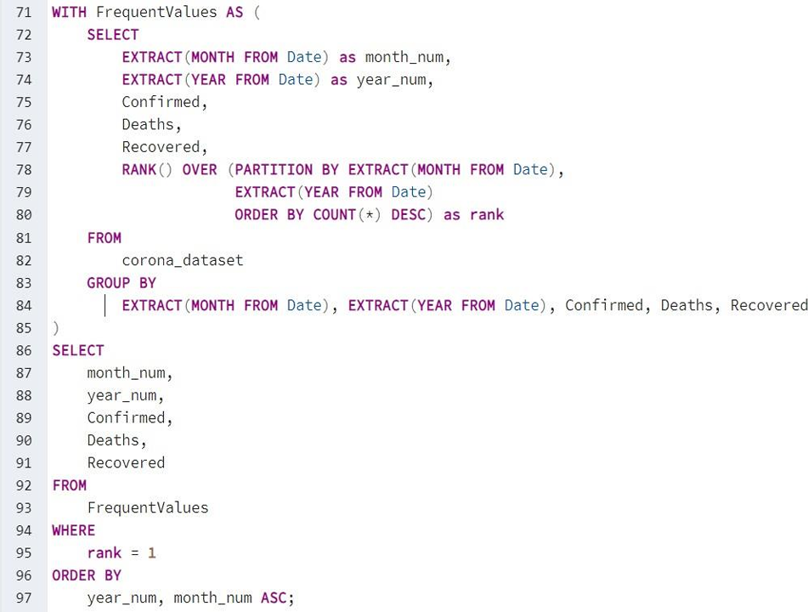
Find minimum values for confirmed, deaths, recovered each month

Slide 15
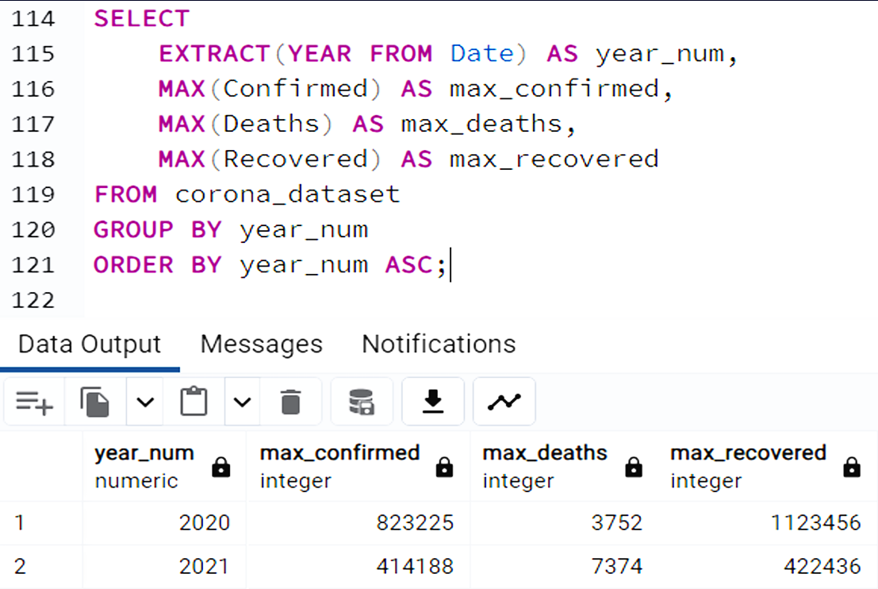
Find maximum values for confirmed, deaths, recovered each month

Slide 16
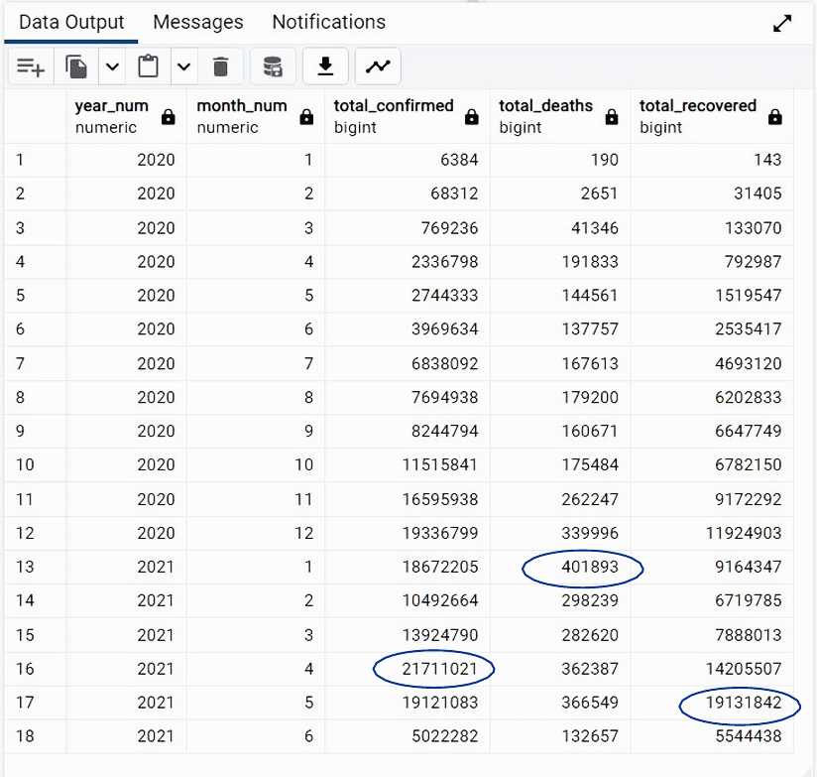
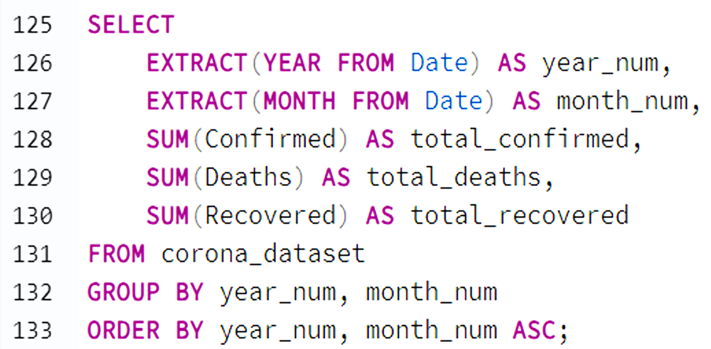
The total number of case confirmed, deaths, recovered each month

Slide 17
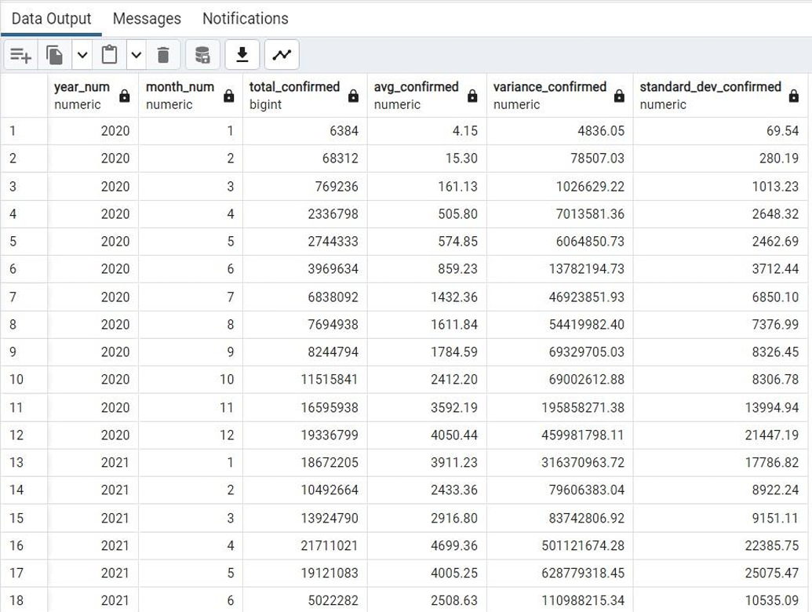
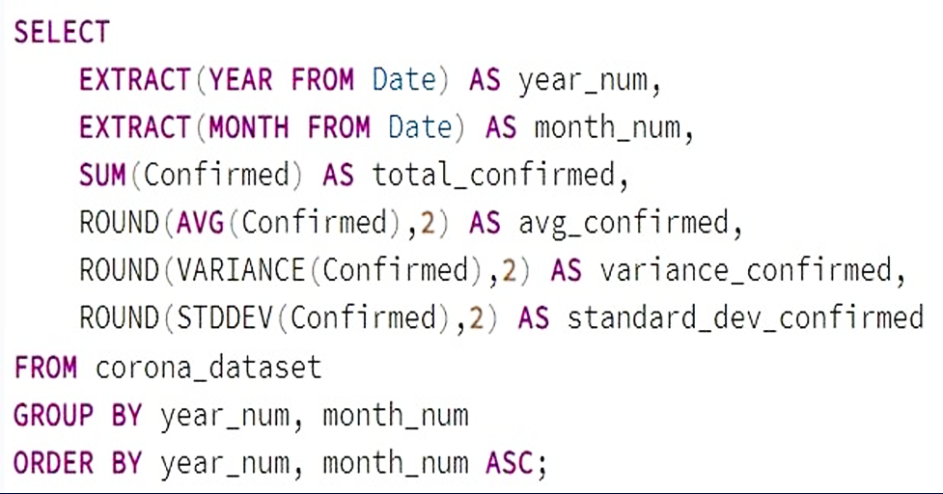
Check how coronavirus spread out with respect to confirmed cases per month

Slide 18
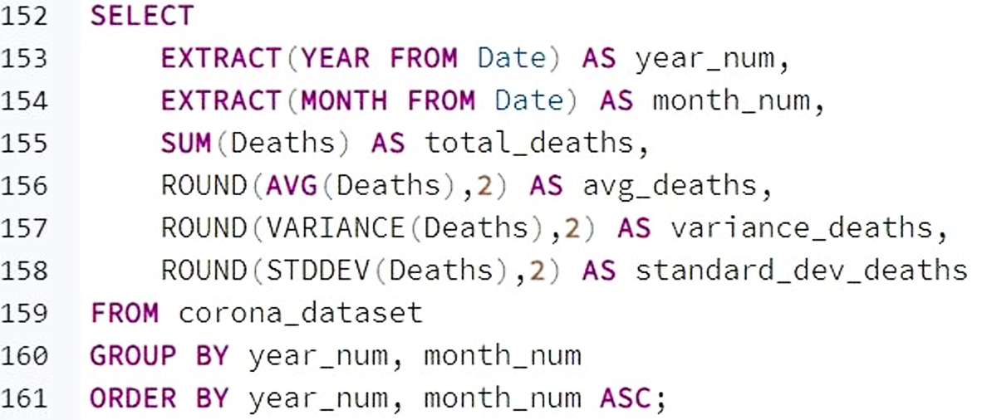
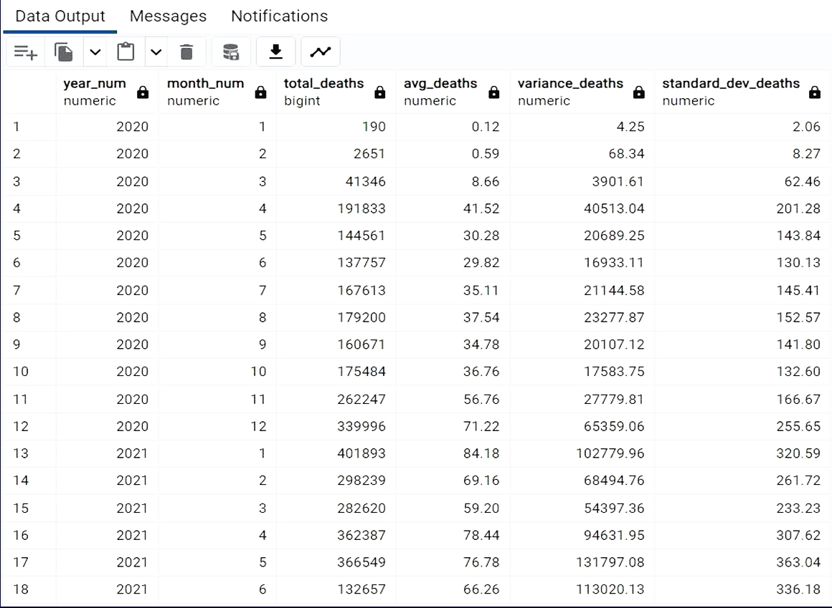
Check how coronavirus spread out with respect to death cases per month

Slide 19
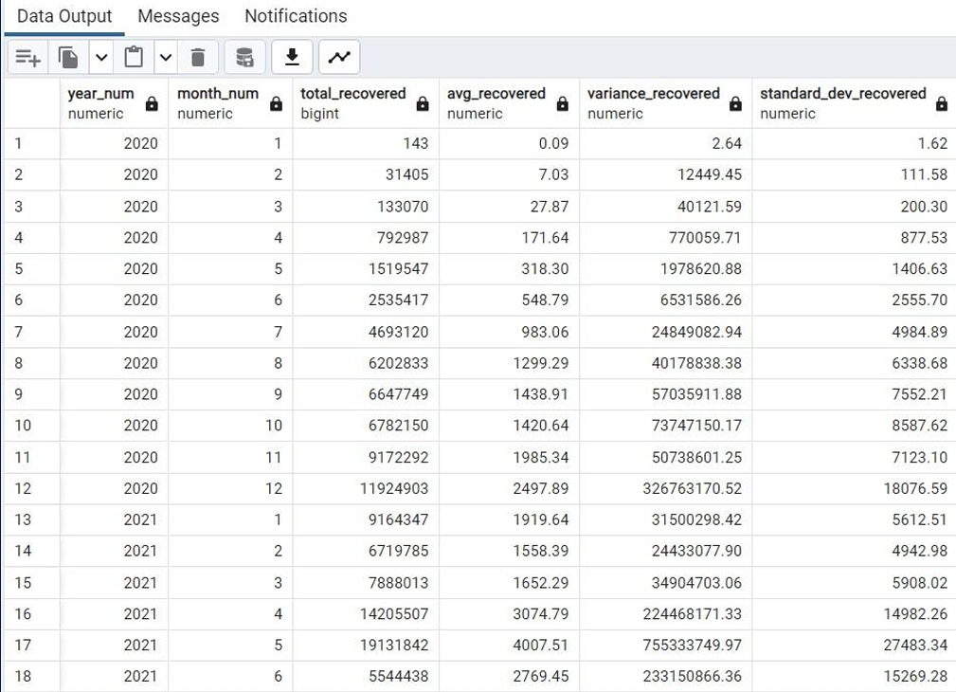
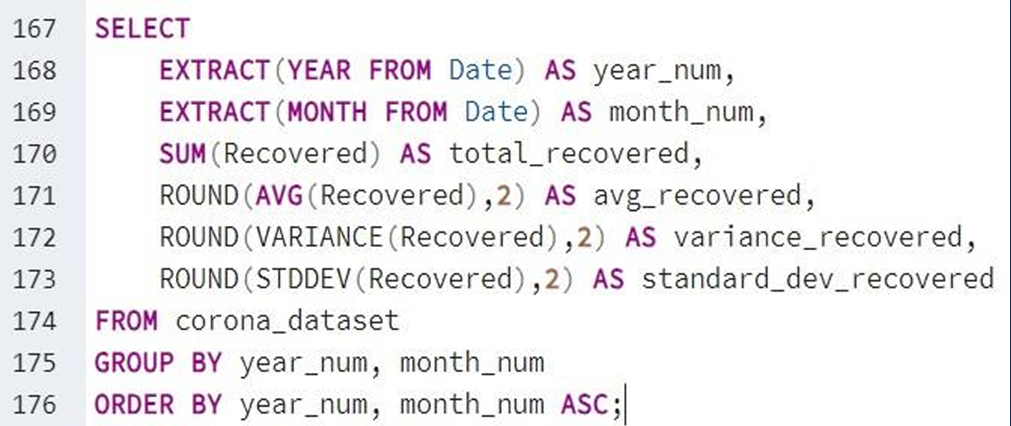
Check how coronavirus spread out with respect to recovered cases per month

Slide 20
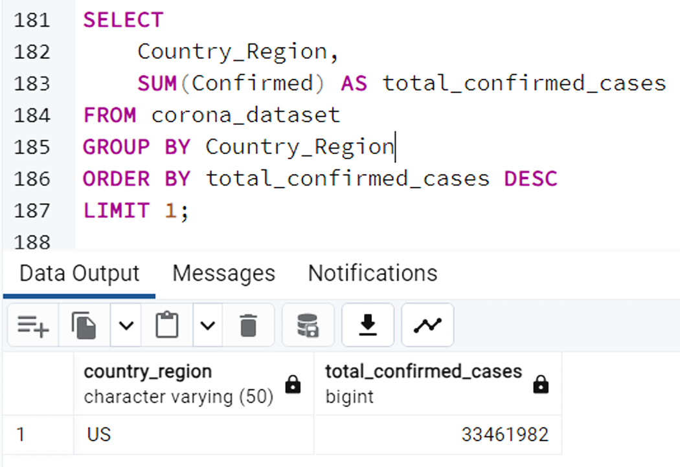
Find the country having the highest number of confirmed cases

Slide 21
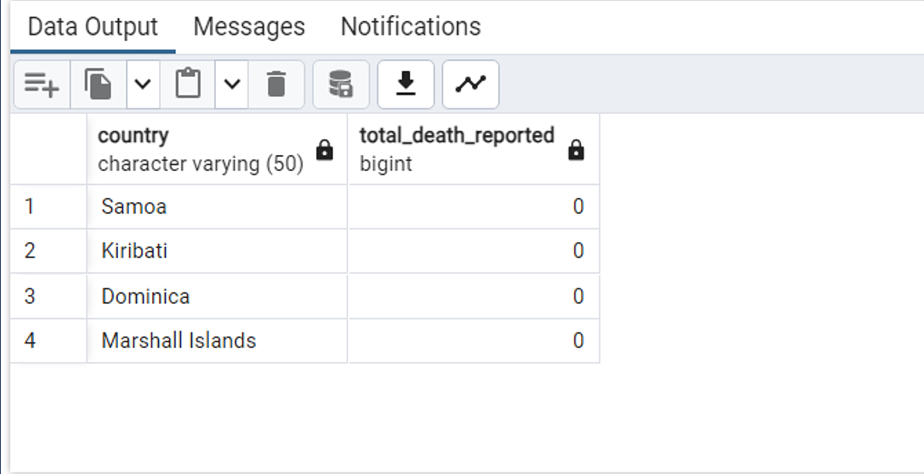
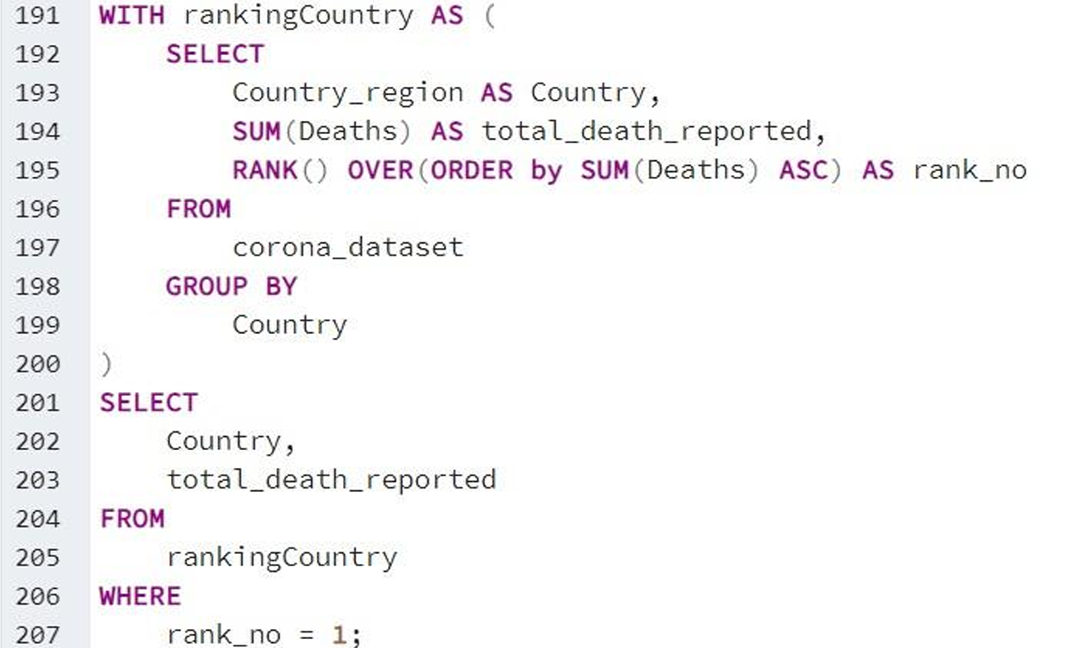
Find the country having lowest number of death cases

Slide 22
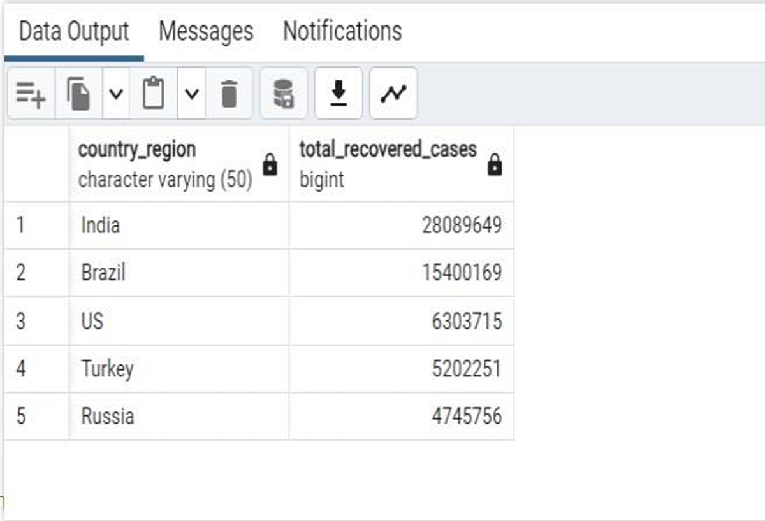
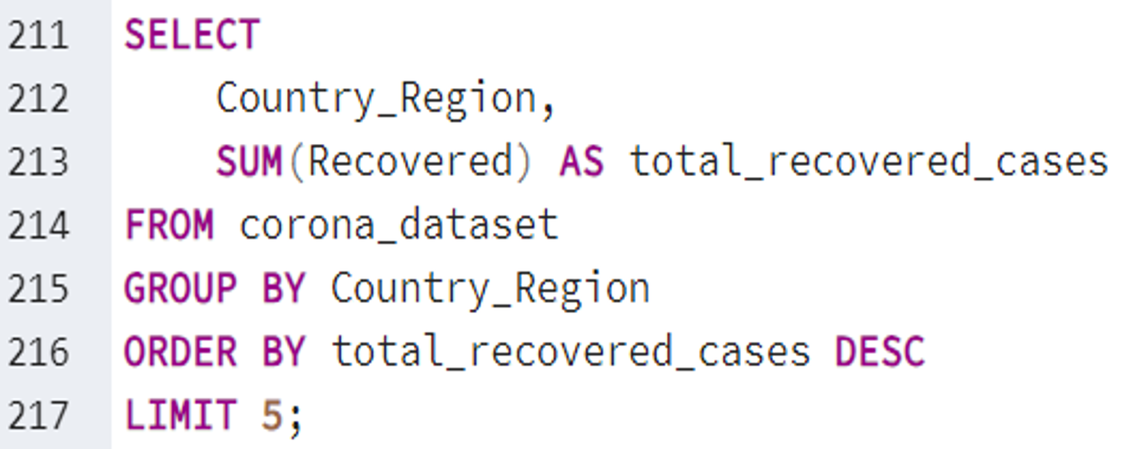
Find the country having highest number of recovered cases

Slide 23
Thank you!

